Slide 1

Django – Form Processing
Sequence Diagram

Slide 2
Sequence Diagram
Design the flow

Slide 3
Sequence Diagram
A sequence diagram shows object interactions arranged in time sequence.
It depicts the objects and classes involved in the scenario and the sequence of messages exchanged between the objects needed to carry out the functionality of the scenario.
These diagrams are widely used by businessmen and software developers to document and understand requirements for new and existing systems.

Slide 4
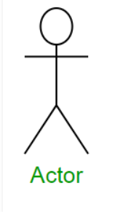
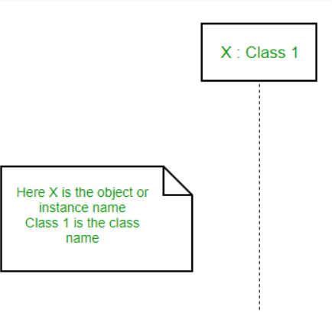
Sequence Diagram
Actors – An actor in a UML diagram represents a type of role where it interacts with the system and its objects.
Lifelines – A lifeline is a named element which depicts an individual participant in a sequence diagram. So basically each instance in a sequence diagram is represented by a lifeline. Lifeline elements are located at the top in a sequence diagram.
The comment object is a rectangle with a folded-over corner as shown below. The comment can be linked to the related object with a dashed line.

Slide 5
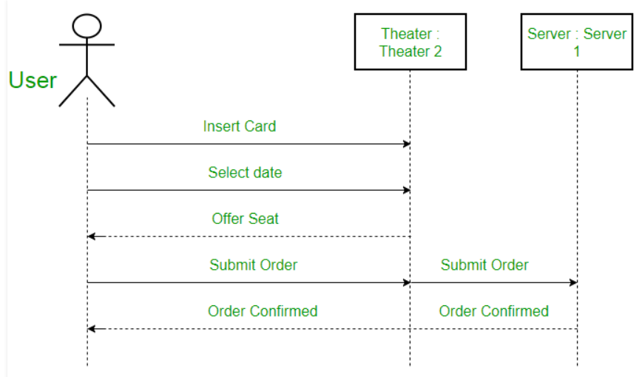
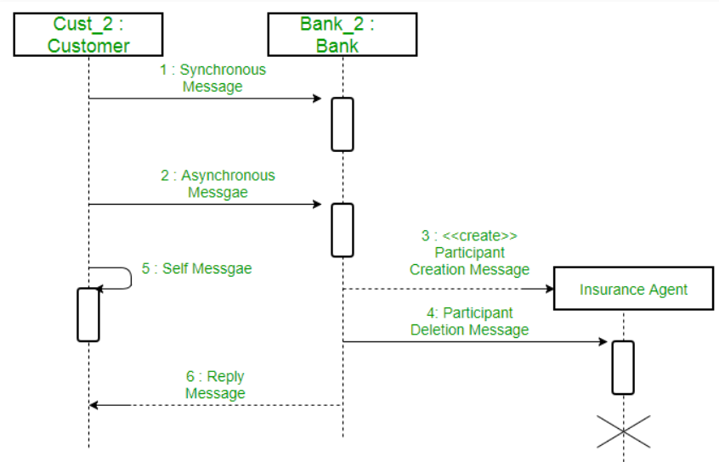
Sequence Diagram
Difference between a lifeline and an actor – A lifeline always portrays an object internal to the system whereas actors are used to depict objects external to the system.
Messages – Communication between objects is depicted using messages. The messages appear in a sequential order on the lifeline. We represent messages using arrows. Lifelines and messages form the core of a sequence diagram.

Slide 6
Sequence Diagram
Messages Arrows
  Synchronous message
  Asynchronous message
  Return message
  Participant creation message
  Participant destruction message
  Reflexive message

Slide 7

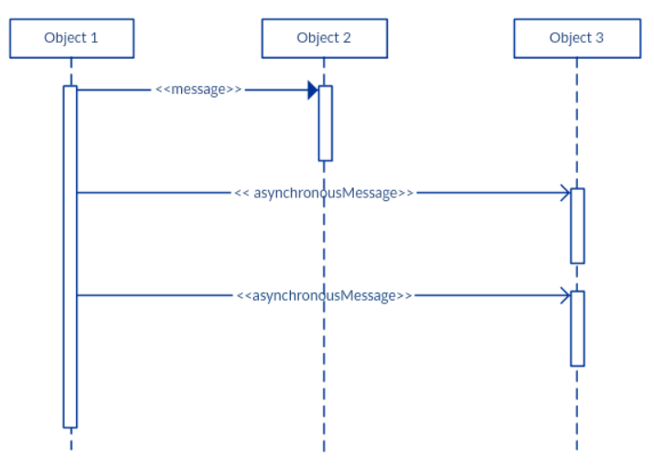
Sequence Diagram
A synchronous message is used when the sender waits for the receiver to process the message and return before carrying on with another message. The arrowhead used to indicate this type of message is a solid one, like the one below.
An asynchronous message is used when the message caller does not wait for the receiver to process the message and return before sending other messages to other objects within the system. The arrowhead used to show this type of message is a line arrow like shown in the example below.

Slide 8
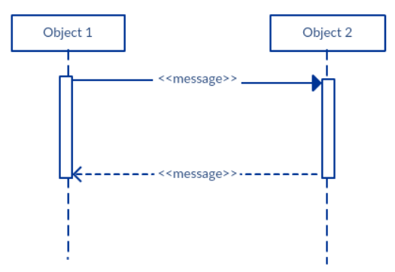
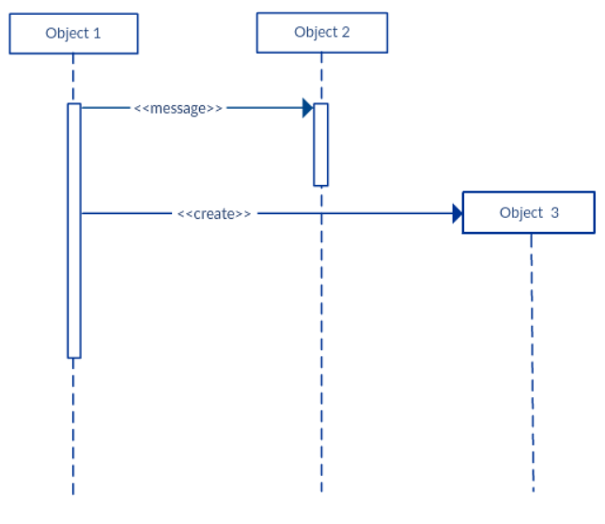
Sequence Diagram
A return message is used to indicate that the message receiver is done processing the message and is returning control over to the message caller. Return messages are optional notation pieces, for an activation bar that is triggered by a synchronous message always implies a return message.
Participant creation message: Objects do not necessarily live for the entire duration of the sequence of events. Objects or participants can be created according to the message that is being sent.
If the created participant does something immediately after its creation, you should add an activation box right below the participant box.

Slide 9
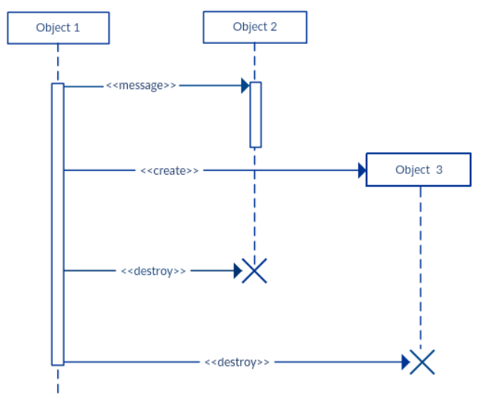
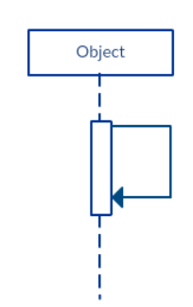
Sequence Diagram
Participant destruction message: Likewise, participants when no longer needed can also be deleted from a sequence diagram. This is done by adding an ‘X’ at the end of the lifeline of the said participant.
Reflexive message: When an object sends a message to itself, it is called a reflexive message. It is indicated with a message arrow that starts and ends at the same lifeline as shown in the example below.

Slide 10
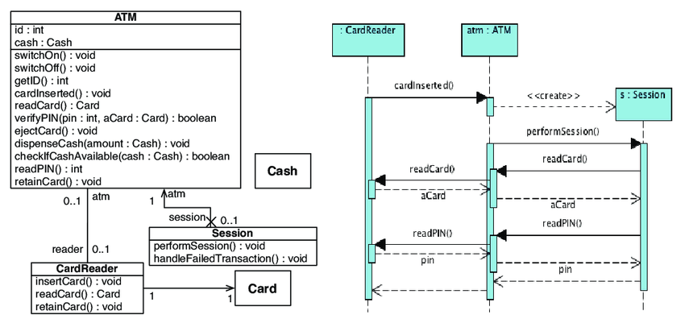
Sequence Diagram
Sequence Diagram can be obtained from Class Diagram.
Class Diagram is a diagram that we can create based on the Object Oriented Paradigm.
Ragnhild Van Der Straeten, Jorge Pinna Puissant, and Tom Mens, Assessing the Kodkod Model Finder for Resolving Model Inconsistencies

Slide 11
Sequence Diagram (example)
User Registration
User Login
User List
User Delete
User Modify
<<actor>>
User
registration
loginPage
validate
Error
Welcome
UserList
UserDelete
UserModify
Name, email,
Nationality,
User ID,
Password
Registration
Status
(user ID, password)
verifyLogin
(userID, password)
:true, session user
If role=admin
:false
Delete(userID)
Login error
Deletion result
Modify(userID)
Response to user
Modification result
Response to user

Slide 12
Sequence Diagram (Example 2)
List members
Add members
Update member
Delete confirm
<<actor>>
User
Update
member
Delete Confirm
List_members
Add_member
validate
Error
validate
Error
:cancel
Error
validate
All info about
members
Verify the
data type
:false
:false
:true, add user
Modify(ID)
Modification result
Delete(ID)
Deletion result

Slide 13
Summary
Sequence Diagram

